Slide 1

recommender system
df = pd.read_csv('data/complete_dataset.csv')
IBM Capstone project

Slide 2
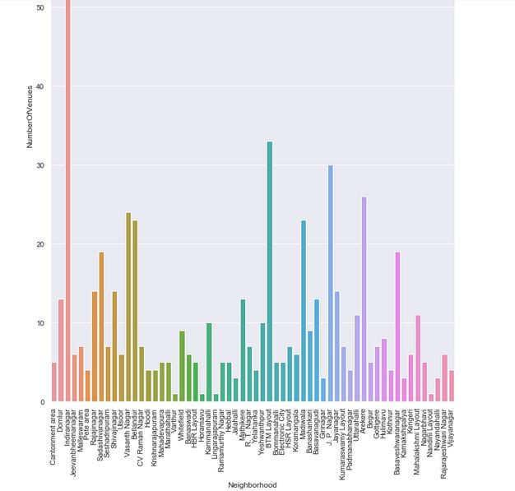
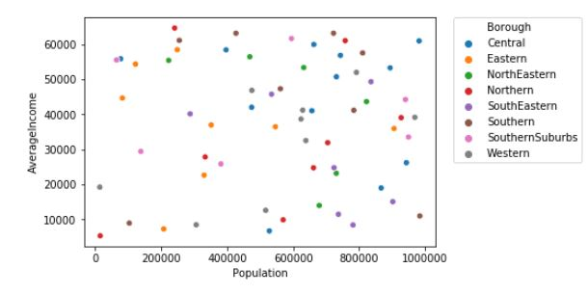
Methodology
Recommender System
Machine learning
Exploratory analysis
Inferential analysis

Slide 3
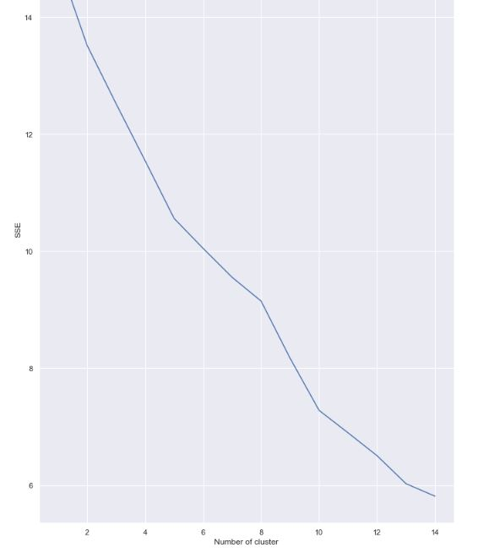

Slide 5
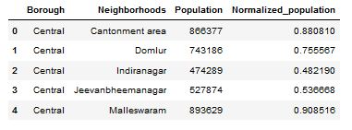

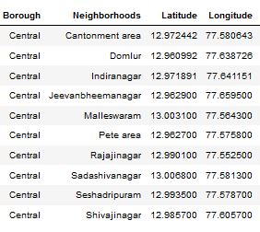
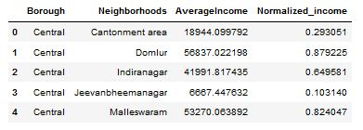
Datasets

Slide 6

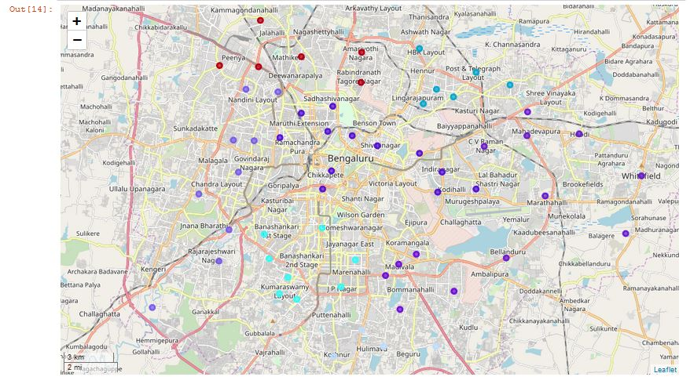
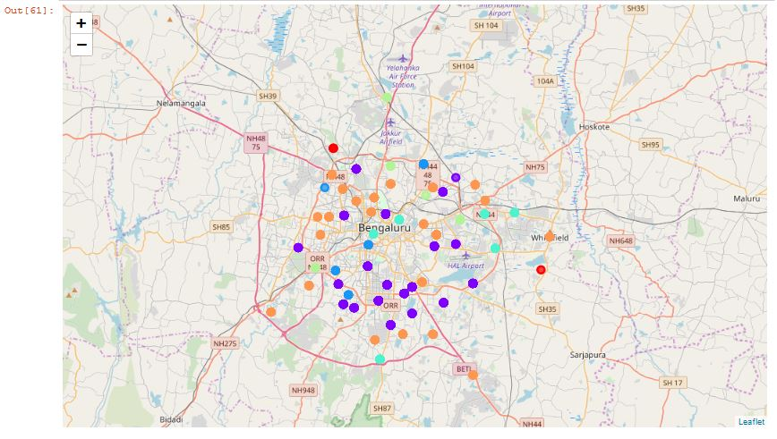
Mapping and clustering

Slide 7
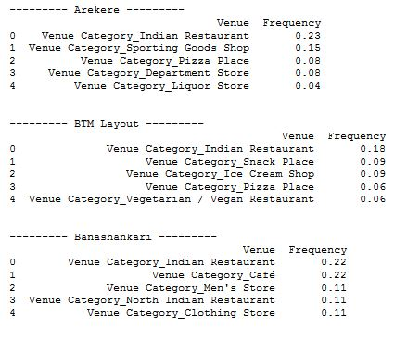

Results and conclusion

Slide 8

Thank You!

